Slide 2
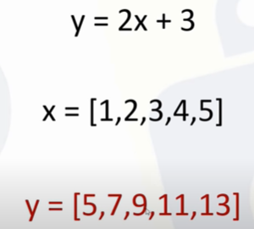
LINEAR REGRESSION :

